Slide 1
Customer Churn Analysis and Insights
A data-driven approach to understanding customer churn and behavior
Sabin Sa Mi

Slide 2

AGENDA
Introduction to the dataset
Key customer churn insights
Demographic and service usage analysis
Financial impact of churn
Recommendations and next steps

Slide 3
Objective: The goal of this analysis is to identify key factors contributing to customer churn and provide actionable recommendations to reduce churn rates.
Dataset: IBM’s Sample Telecom Customer Churn Dataset with columns like Churn, Tenure, MonthlyCharges, Internet Services
Key Metrics: We will analyze churn rates, customer tenure, monthly charges, and service usage.

Slide 4
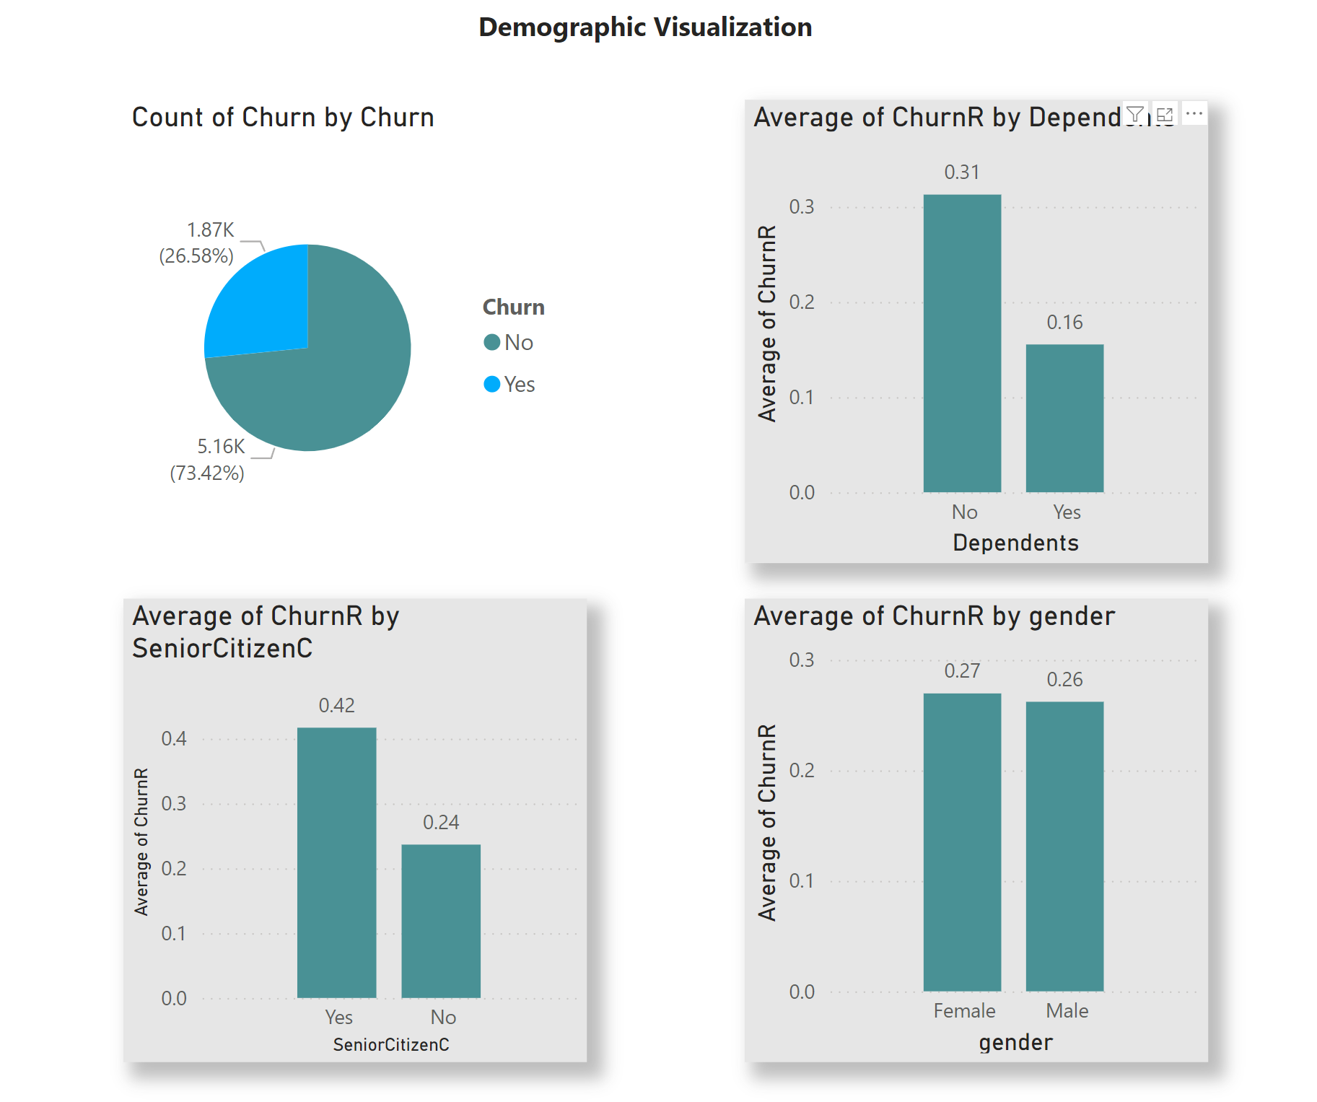
Notes:
73% of customers have not churned, while 27% have.
31% not having dependent have churned
425 who are senior citizen have churned
Gender is not really affecting in customer churn

Slide 5
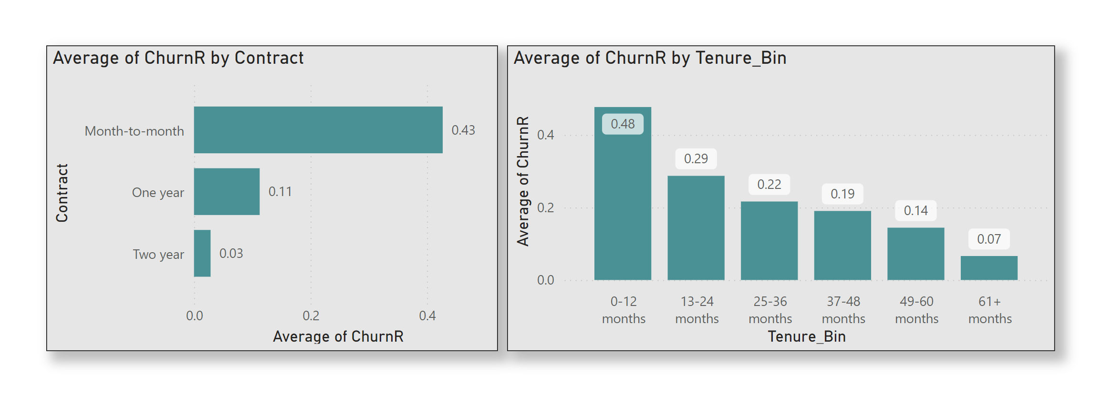
Churn rate over time by tenure
Notes:
Customers with less than 12 months of tenure have a churn rate of 43%, while customers with tenure longer than 60 months have a churn rate of only 7%.
Month-to-month contracts have the highest churn rate (43%), while two-year contracts have the lowest (33%).
Insight: "Customers with shorter contracts are more likely to churn. Consider offering incentives for long-term contracts."

Slide 6
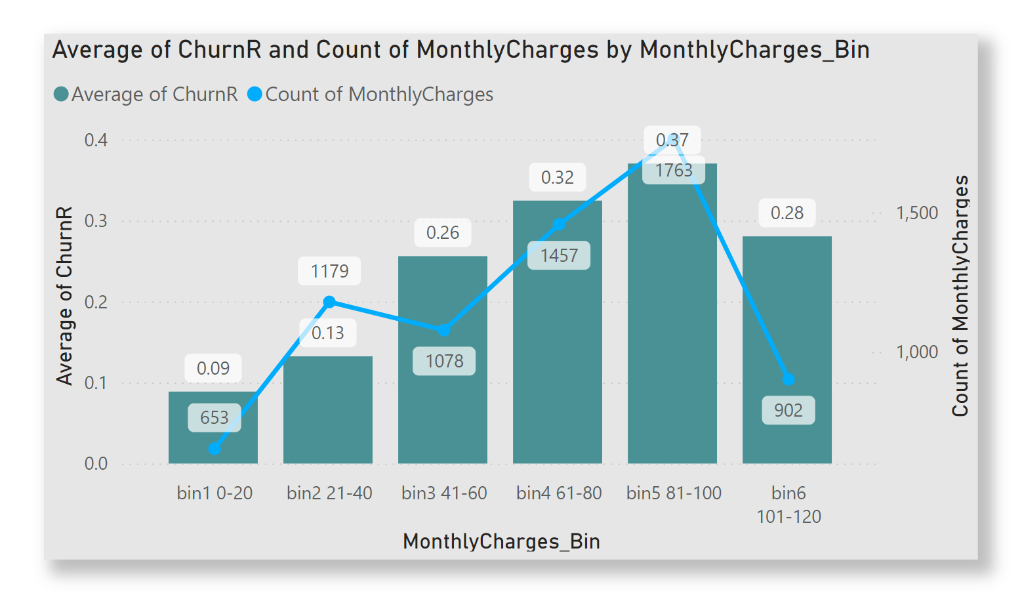
Notes:
Most customers fall in the 81-100 range for monthly charges.
Customers paying more than $60 are more likely to churn.

Slide 7
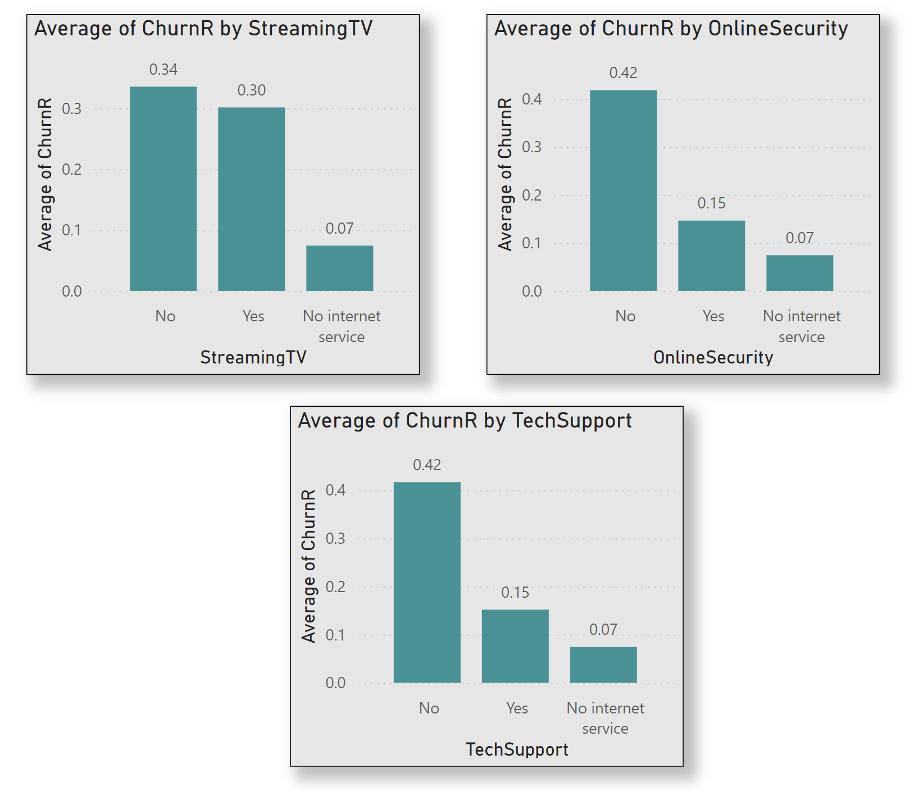
Notes:
Customers without online security and tech support are significantly more likely to churn
Key Insight: "Bundling services like tech support and online security might reduce churn."

Slide 8
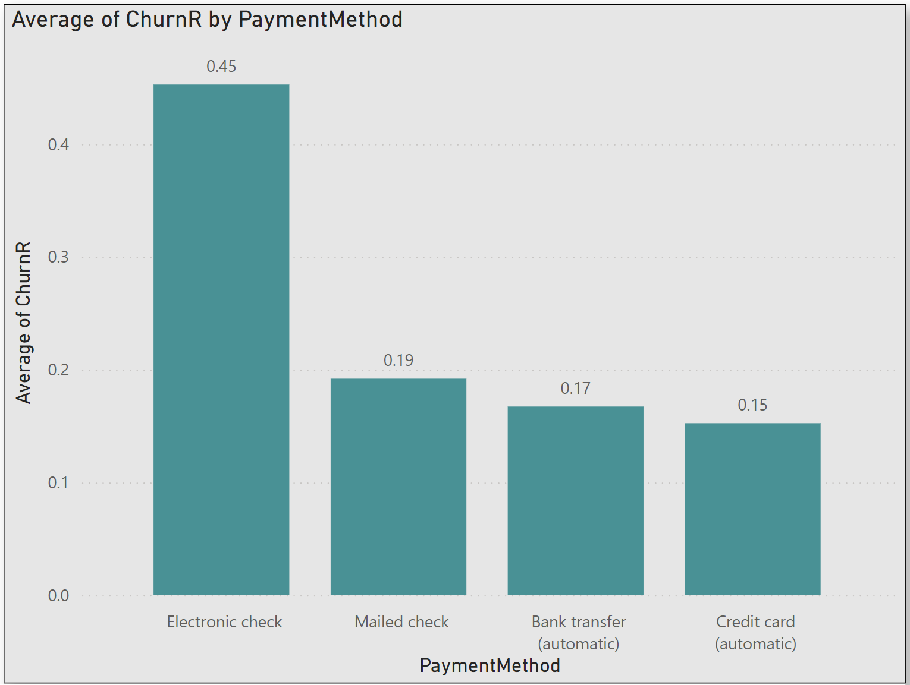
Notes:
Customers using Electronic check have a churn rate of 45%, whereas customers with automatic bank transfers churn at only 17%.
Insight: "Encourage automatic payment methods to reduce churn.

Slide 9

RECOMMENDATIONS
Targeted Retention
Service Improvements
Payment Method Incentives
Notes:
Offer discounts or contract extensions for customers with high monthly charges or short tenures
Consider enhancing customer support services for customers without TechSuport or OnlineSecurity
Encourage customers to switch to automatic payment methods to reduce churn

Slide 10

Summary
Customers with shorter tenure and higher monthly charges are more likely to churn
Services like tech support and online security can significantly reduce churn

Slide 11
Any Questions ?

Slide 12
THANK YOU
Sabin Sa Mi

